Slide 1
Managing Azure Virtual Machines with PowerShell
Mike Nelson
Microsoft MVP, Azure Advisor, Citrix CTP, VMware vExpert
@nelmedia
#globalazure
#azure

Slide 2
Topics
Azure Virtual Machines
The Many Ways of Creating an Azure VM
The Portal
PowerShell

Slide 3
Azure Virtual Machine Benefits
Choice
Choose from thousands of pre-configured VM images or configure, capture, and upload your own custom images
Leverage VM Extensions to do custom post-deployment configuration
Scalability & Reliability
Select system profiles to best match your workload
Configure drives for size and performance
Leverage VM Scale Sets to scale from one to thousands of VM instances
Access & Security
Configure Azure networking to the topology you require
Extend your on-premises infrastructure into the Cloud
Notes:
Objective: Introduce the advantages of VM offerings on the Azure Platform
Notes:
There are 3 key areas where Azure VM’s offer a significant advantage:
Choice – Users can choose from a frequently-updated gallery of pre-configured VM images, or they can prepare and upload their own (and what they upload can either be an image – multiple VM’s get made from images – or a ready-to-run VM. On top of all that, VM Extensions can be used to run post-configuration setup steps.
Scalability/Reliability – Users can choose VM configurations (CPU, RAM, HDD, etc) that matches their workloads. They can also configure attached storage as needed (and as the chosen VM tier permits), and then use VM Scale Sets to horizontally scale their images across multiple VM instances.
Access/Security – Users can configure Azure networking to isolate their VM’s within the Azure network, and even extend that network topology to connect to their on-premises network or to other Azure networks.

Slide 4
Choosing a VM Size
High Performance Compute
General Purpose
Compute Optimized
Memory Optimized
GPU
A0 – A5 Basic
F1, F2, F4, F8, F16
D11 – D14
NV6, NV12, NV24
A8 – A11
A0 – A7 Standard
D11v2 – D15v2
NC6, NC12, NC24, NC24r
H8, H8m, H16, H16m, H16r, H16mr
D1 – D4
G1 – G5
D1v2 – D5v2
*Not all sizes available in all regions
Notes:
CPU estimated by ACU – Azure Compute Units
Objective: Illustrate the many different possible VM hardware configurations, slotted by purpose.
Notes:
A key takeaway here is that part of provisioning your VM’s is determining the Family/Size that best addresses your needs.
Information Source: https://azure.microsoft.com/en-us/pricing/details/virtual-machines/linux/
General:
A0 – A4 Basic: 1-8 cores, .75-14 GB RAM. Entry-level, economical. Good for dev workloads, dev/test
A0 – A7 Standard: 1-8 cores, .74-56 GB RAM. Entry-level, economical. Supports load-balancing, auto-scaling. Good for dev workloads, dev/test
D1 – D4 (v1): 1 – 8 cores, 3.5 – 28 GB RAM. More powerful CPU than A, feature SSD’s. Also available in Ds (premium storage
D1v2 – D5vs: 1 – 16 cores, 3.5 – 56 GB RAM. Newer-gen D-series, 35% faster CPU than D.
Compute Optimized:
F1 – F16: 1 – 16 cores, 2 – 32 GB RAM. Higher CPU to memory ratio Good for batch-processing, web servers, analytics, gaming.
Memory Optimized:
D11 – D14 (v1): 2 – 16 cores, 14 – 112 GB RAM. Ideal for memory-intensive enterprise applications.
D11v2 – D15v2: 2 – 20 cores, 14 – 140 GB RAM. Ideal for memory-intensive enterprise applications.
GPU
NV6 - NV24: Good for high-end remote visualization, deep-learning, predictive analytics. V series focuses on visualization.
NC6 - NC24/r: Good for high-end remote visualization, deep-learning, predictive analytics. C series focuses on compute. (24r is for tightly-coupled parallel computing workloads with 2nd low-latency, high-throughput NIC)
HPC
A8 – A11: A8 & A10 have 8 cores & 56 GB RAM, A9 & A11 have 16 cores & 112 GB RAM. Entry-level, economical. Good for dev workloads, dev/test
H8, H16, m&r: 8, 16 cores, 56GB – 224 GB RAM. M = high memory, r = RDMA network. Good for risk modeling, seismic & reservoir simulation, molecular modeling, genomic research.
COMING SOON
L-Series: “Storage optimized”

Slide 5
Storage Disks
Standard Storage
Premium Storage
Azure File Storage
Cloud-scale reliable storage
Maximum 500 IOPS, 60 MB per second throughput per disk
Available in all VM Sizes
High-performance, low-latency disk support, ideal for I/O intensive workloads
Maximum 5000 IOPS, 200 MB per second throughput per disk
Only supported in “S” series VMS (DS, DSv2, GS, FS)
Locally redundant storage only
Mount Azure Storage as network share volumes
Can be accessed via SMB 3.0 or REST APIs
Up to 1000 IOPS, up to 60 MB/second throughput per share
Max share size = 5TB, Max file size = 1 TB.
Notes:
Objective: To discuss the available different kinds of storage that can be used by VM disks
Notes:
Data disks have max capacity of 1 TB, but can be striped for larger sizes, up to 64 TB of storage per VM
Azure imposes limits on the number of data disks and amount of bandwidth available, depending on the VM size. (eg F2S = max 4 data disks, F16S = max 32 data disks)
Per-Disk (and Share) IOPS are 8KB operations
Standard Storage
IOPS and Throughput per disk above are for Standard, basic is lower
Entire storage account (not just single disk) has max IOPS of 20,000
Premium Storage
IOPS and Throughput per disk above are for P30, lower for P10, P20
With a GS5, supports up to 80,000 IOPS and 2000 MB/s throughput per VM
Entire storage account has a max total throughput rate of 50 Gbps
No Azure-imposed limit on the number of file shares that can be mounted, no limit on the number of VM’s that can simultaneously mount a File Storage share
Can also be mounted by on-premises clients (Windows) - on prem mounting requires Windows 8 or newer (Server 2012+) and firewall cooperation
No limit on # of files in a share (other than overall share size)

Slide 6
Disks vs Images
OS Images
Microsoft
Partner
User
Base OS image for new Virtual Machines
Sys-Prepped/Generalized/Read Only
Created by uploading or by capture
Disks
OS Disks
Data Disks
Writable Disks for Virtual Machines
Created during VM creation or during upload of existing VHDs.
Notes:
Objective: To present the difference between an OS Image and a VM Disk
Notes:
Images are reference VHDs (almost like a template) for realizing OS Disks for VMs.
VM’s typically have at least 2 disks:
OS Disk (C on Windows), persistent content. SATA access
Temp Storage (D on Windows), SATA access, NOT PERSISTENT (Temp storage only) (Good for TempDB on SQL images, for example)
Additionally, VM’s can have 0->n (depends on characteristics of VM size chosen) data disks
Drive-letter assigned on Windows, SCSI, Persistent
Can be striped for performance
Limit on # determined by VM family/size

Slide 7
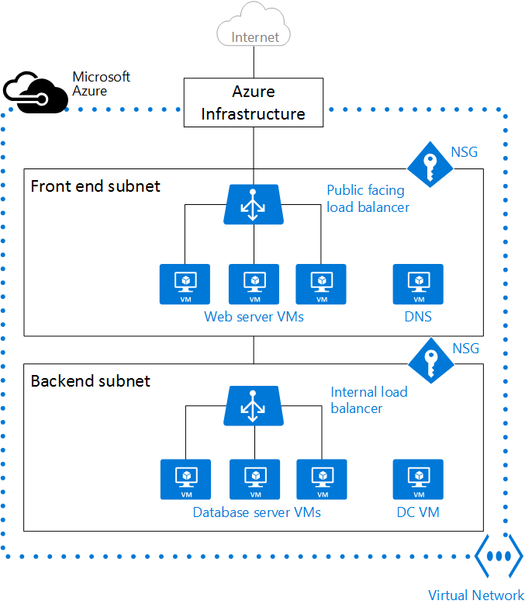
Virtual Networks
“Bring your own network”
Provides security and isolation by creating a private network inside of Azure
Supports:
Defining subnets
“Peering” with other non-overlapping VNETs in the same region
Defining Network Security Groups (ACL rules)
Allows you to create complex and/or sophisticated network topologies around your VM’s
Notes:
Objective: To introduce the concept of Virtual Networks (VNETs) in Azure
Notes:
A VNET is “your private network within the overall Azure network”
Along with the VNET, you can leverage other tools like Load Balancers, Network Service Gateways, Application Gateways, Public IP Addresses, etc.
Peering (new feature) allows 2 VNETs to be maintained as separate resources, but VMs in those VNETs can communicate with each other directly via IP Address.
VNETs can define Network Security Groups, which contain ACL rules that allow or deny traffic to VM instances in a VNET.
NSG’s can be associated with subnets or individual VM instances
Illustration source: https://azure.microsoft.com/en-us/documentation/articles/virtual-networks-overview/

Slide 8
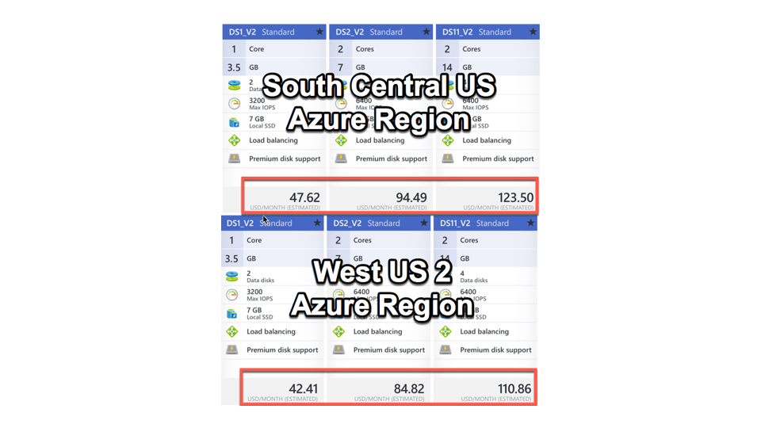
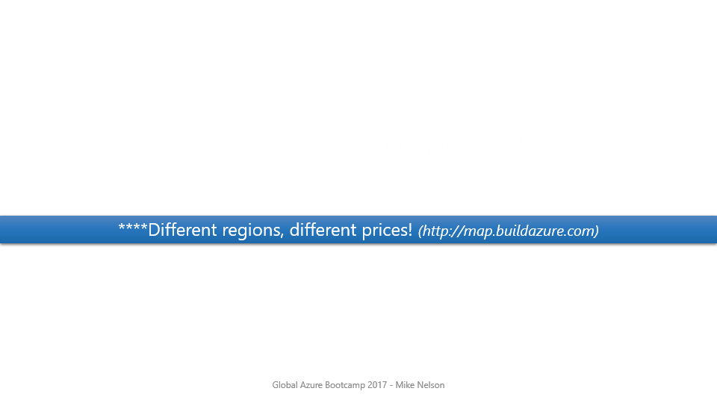
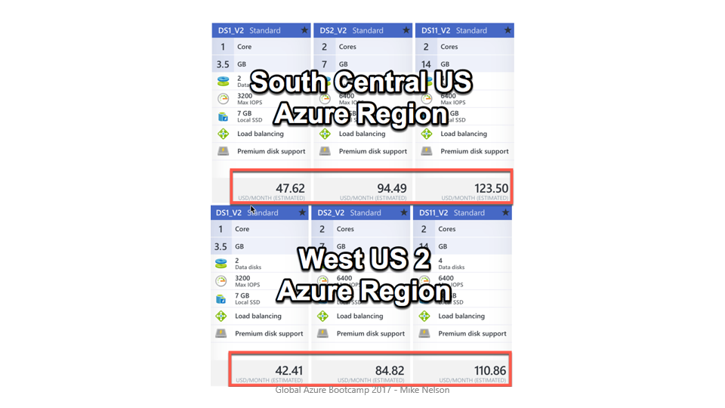
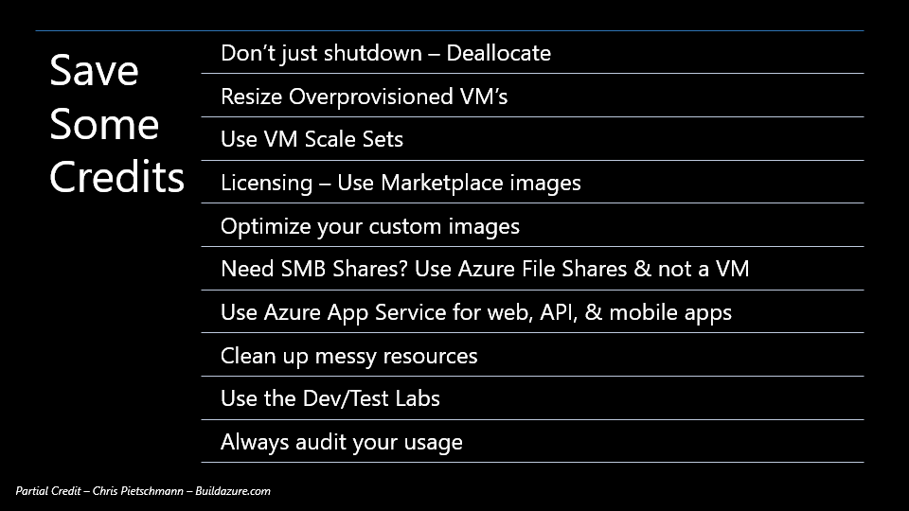
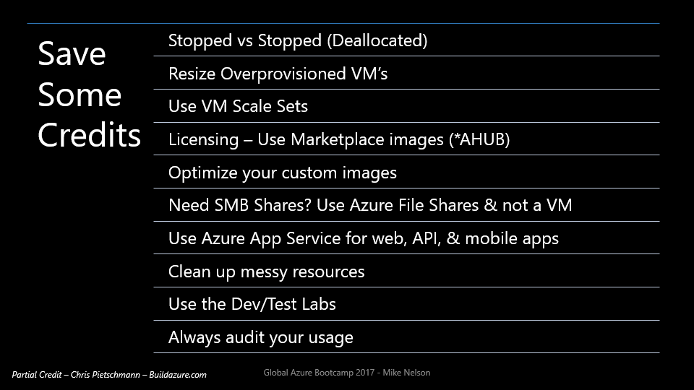
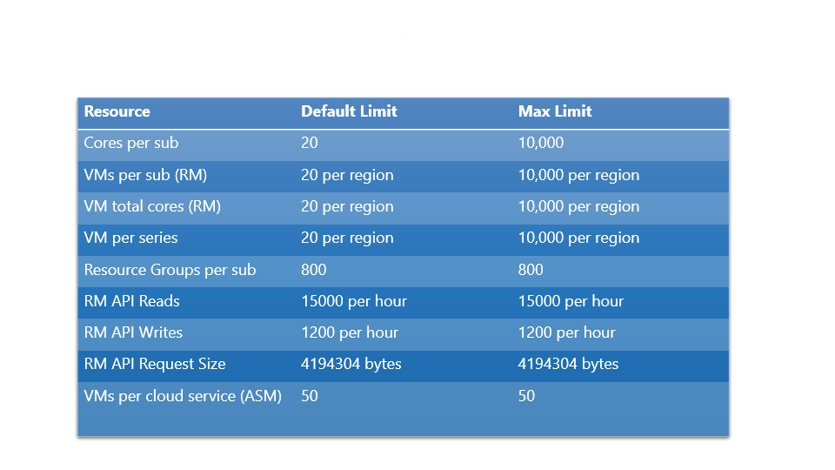
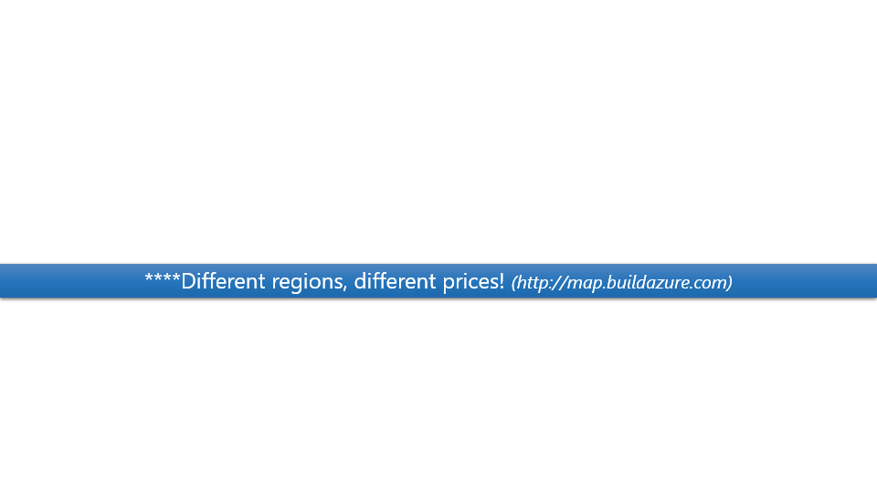
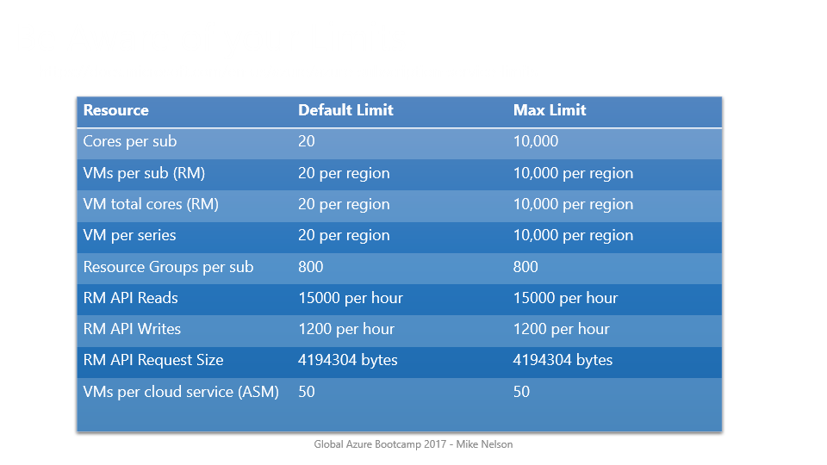

Slide 9
Control Your Spend
https://azure.microsoft.com/en-us/pricing/calculator/
****Different regions, different prices! (http://map.buildazure.com)

Slide 10
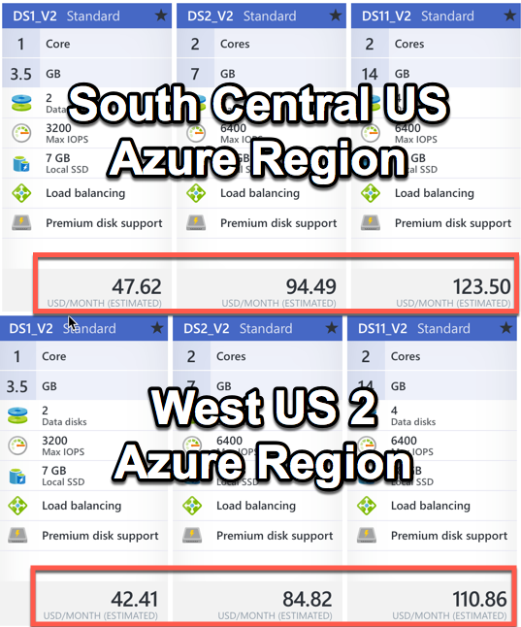

Slide 11
Save Some Credits
Stopped vs Stopped (Deallocated)
Resize Overprovisioned VM’s
Use VM Scale Sets
Licensing – Use Marketplace images (*AHUB)
Optimize your custom images
Need SMB Shares? Use Azure File Shares & not a VM
Use Azure App Service for web, API, & mobile apps
Clean up messy resources
Use the Dev/Test Labs
Always audit your usage
Partial Credit – Chris Pietschmann – Buildazure.com
Notes:
You can stop the virtual machine by connecting via RDP and power off by Windows, in this case it will be with status Stopped. In this state it will continue charging and the internal IP and the public will be preserved.
If the state of the machine is in Stopped (Deallocated) that means you have made a shutdown by Web Management Interface Azure ( SHUTDOWN BUTTON ). In this way the cost of virtual machine will not be charged, but the public and internal IP will be deleted.
Azure Hybrid Use Benefit-
You can deploy VMs from specific Marketplace images that are pre-configured with Azure Hybrid Use Benefit - Windows Server 2016, Windows Server 2012R2, Windows Server 2012 and Windows Server 2008SP1.
You can upload a custom VM and deploy using a Resource Manager template or Azure PowerShell.
Windows 10 HUB is in preview. Only E3/E5 with EA and SA can utilize.

Slide 12
Be Aware of your Limits
https://docs.microsoft.com/en-us/azure/azure-subscription-service-limits
Resource | Default Limit | Max Limit
Cores per sub | 20 | 10,000
VMs per sub (RM) | 20 per region | 10,000 per region
VM total cores (RM) | 20 per region | 10,000 per region
VM per series | 20 per region | 10,000 per region
Resource Groups per sub | 800 | 800
RM API Reads | 15000 per hour | 15000 per hour
RM API Writes | 1200 per hour | 1200 per hour
RM API Request Size | 4194304 bytes | 4194304 bytes
VMs per cloud service (ASM) | 50 | 50

Slide 13
Provisioning a VM
Notes:
Objective: This section will discuss the steps involved in and key options for provisioning VMs in Azure.

Slide 14
Provisioning Steps
Image
Select an image from the VM Gallery
Upload your own Custom-Prepped Image
Scale
General Purpose
Compute Optimized
Memory Optimized
GPU
Boot
Create new disk in Storage
Boot the machine
High Performance Compute
Use a Custom ARM Template
Notes:
Objective: To illustrate typical straightforward processes for provisioning VMs
Notes:
The process of provisioning a VM usually follows 3 basic steps:
Choose the VM Image, either from a pre-existing gallery of images, by preparing and uploading your own image, or via an ARM template (which references either a pre-existing image or one you uploaded)
Choose the size and performance characteristics for your VM, depending on its intended purpose (general, compute-heavy, memory-intensive, requiring GPU processing, or HPC.)
Boot the VM instance – generate a new VM disk instance in storage, then boot the machine.

Slide 15
Many Ways to Create a VM
Portal
PowerShell
Azure CLI
ARM - ASM Template
REST API
VS SDK
SCCM App Controller
3rd Party Admin

Slide 16
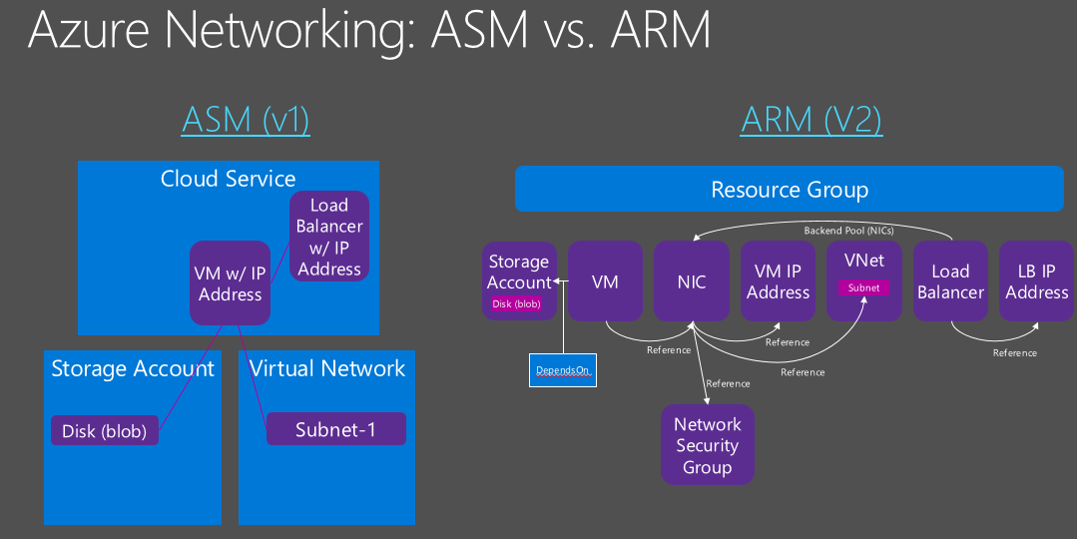
Notes:
ASM is RDFE

Slide 17
Make Way for ARM
ASM (Classic)
Traditional deployments
K.I.S.S.
Is being deprecated
ARM – The New Way
Logical Grouping
Some new resources require it
Commands run 1-by-1 = slow
Shared and reusable
Tagging
Commands run batched = faster

Slide 18
The Azure Portal

Slide 19
Setting Up PowerShell
Framework
Latest 5.1
Cmdlets
Azure Downloads
Keep Current
PowerShellGet
Web Platform Installer
GitHub
Standalone
GitHub Releases
Azure Downloads
Chocolatey
Win10 & 2016 “Automagic”
PowerShell
3.0 is minimum
Beta 6 (GitHub)
5.x is best
PowerShell DSC - Learn It!

Slide 20
PowerShell Management Methods
ASM (Classic) – Built-In access via WinRM
ARM – Requires Config pre or post VM (w/certs)
Internal
Windows Jump Box
Linux OMI Provider via PSRP
SMT
External
RDP / SSH
HTTPS WinRM tcp/5986 – PoSH Remoting (Certs)
SMT

Slide 21
Demos & Scripts

